Slide 1
Tadoa Ando
By,
Elizabeth Sankalpana S.

Slide 2
Tadoa Ando
Born: September 13, 1941 Minato-ku, Osaka, Japan
Nationality:Japanese
Practice:Tadao Ando Architects & Associates

Slide 3
Early life
Ando was born in 1941 in Minato-ku, Osaka, Japan, and raised in Asahi-ku in the city. He led an eventful life, working as a truck driver and boxer prior to settling on the profession of architecture, despite never having taken formal training in the field. Struck by the Frank Lloyd Wright-designed Imperial Hotel on a trip to Tokyo as a second-year high-school student, he eventually decided to end his boxing career of less than two years after graduating from high school and to pursue architecture. He attended night classes to learn drawing and took correspondence courses on interior design.[3] He visited buildings designed by renowned architects like Le Corbusier, Ludwig Mies Van der Rohe, Frank Lloyd Wright and Louis Kahn before returning to Osaka in 1968 to establish his own design studio, Tadao Ando Architects and Associates

Slide 4
He responds both sensitively and critically to the chaotic Japanese urban environment, but maintains a connection to the landscape. Although Ando rejects cultural fads, he uses materials and forms to incorporate the materialism of modern society into his architecture. Accordingly, his concrete and glass buildings reflect, the modern progress underway in both Japan and the world.
In opposition to traditional Japanese architecture, Ando creates spaces of enclosure rather than openness. He uses walls to establish a human zone and to counter the monotony of commercial architecture. On the exterior, the wall deflects the surrounding urban chaos, while on the interior it encloses a private space.

Slide 5
Ando developed a radically new architecture characterized by the use of unfinished reinforced concrete structures. Using a geometric simplicity which reveals a subtlety and richness in spatial articulation, Ando has generated an architecture that shares the serenity and clarity that characterize traditional Japanese architecture.

Slide 6
Style
Ando has a strong background in Japanese culture. He was raised in Japan and lives there. Japanese religion and style of life strongly influenced his architecture and design. Ando's architectural style is said to create a "haiku" effect, emphasizing nothingness and empty space to represent the beauty of simplicity. He favors designing complex spatial circulation while maintaining the appearance of simplicity.

Slide 7
The simplicity of his architecture emphasizes the concept of sensation and physical experiences, mainly influenced by the Japanese culture. The religious term Zen, focuses on the concept of simplicity and concentrates on inner feeling rather than outward appearance. Zen influences vividly show in Ando’s work and became its distinguishing mark. In order to practise the idea of simplicity, Ando’s architecture is mostly constructed with concrete, providing a sense of cleanness and weightiness at the same time. Due to the simplicity of the exterior, construction and organization of the space are relatively potential in order to represent the aesthetic of sensation.

Slide 8
Besides Japanese religious architecture, Ando also designs Christian Churches, such as the Church of the Light (1989) and the Church in Tarumi (1993). Although there are different characteristic between Japanese and Christian churches, Ando treats them in a similar way. He believes there should be no difference in designing religious architecture and houses. As he explains,
We do not need to differentiate one from the other. Dwelling in a house is not only a functional issue, but also a spiritual one. The house is the locus of mind (kokoro), and the mind is the locus of god. Dwelling in a house is a search for the mind (kokoro) as the locus of god, just as one goes to church to search for god. An important role of the church is to enhance this sense of the spiritual. In a spiritual place, people find peace in their mind (kokoro), as in their homeland

Slide 9
Buildings and work
Tadao Ando's body of work is known for the creative use of natural light and for structures that follow natural forms of the landscape, rather than disturbing the landscape by making it conform to the constructed space of a building. Ando's buildings are often characterized by complex three-dimensional circulation paths. These paths interweave between interior and exterior spaces formed both inside large-scale geometric shapes and in the spaces between them.

Slide 10
His "Row House in Sumiyoshi" (Azuma House, 住吉の長屋), a small two-story, cast-in-place concrete house completed in 1976, is an early work which began to show elements of his characteristic style. It consists of three equal rectangular volumes: two enclosed volumes of interior spaces separated by an open courtyard. The courtyard's position between the two interior volumes becomes an integral part of the house's circulation system. The house is famous for the contrast between appearance and spatial organization which allow people to experience the richness of the space within the geometry.

Slide 11
Ando's housing complex at Rokko, just outside Kobe, is a complex warren of terraces and balconies, atriums and shafts. The designs for Rokko Housing One (1983) and for Rokko Housing Two (1993) illustrate a range of issues in traditional architectural vocabulary—the interplay of solid and void, the alternatives of open and closed, the contrasts of light and darkness. More significantly, Ando's noteworthy engineering achievement in these clustered buildings is site specific—the structures survived undamaged after the Great Hanshin Earthquake of 1995.

Slide 12
Ando is right in the Japanese tradition: spareness has always been a part of Japanese architecture, at least since the 16th century; [and] it is not without reason that Frank Lloyd Wright more freely admitted to the influences of Japanese architecture than of anything American."
Like Wright's Imperial Hotel in Tokyo Second Imperial Hotel 1923-1968, which did survive the Great Kanto Earthquake of 1923, site specific decision-making, anticipates seismic activity in several of Ando's Hyōgo-Awaji buildings

Slide 13
Few buildings/Projects built by Tadao Ando are:
Tomishima House, Osaka 1973
Uno House,Kyoto 1974
Tatsumi House, Osaka 1975
Azuma House, Osaka 1976
Glass Block House,Osaka 1978
Glass Block Wall , Osaka 1979

Slide 14
Church on the Water ,Hokkaido 1988
Church of the Light, Osaka 1989
Garden of Fine Arts, Osaka 1990
Suntory Museum, Osaka 1994
Meditation Space, UNESCO , Paris 1995
Church of the Light Sunday School, Osaka 1999

Slide 15
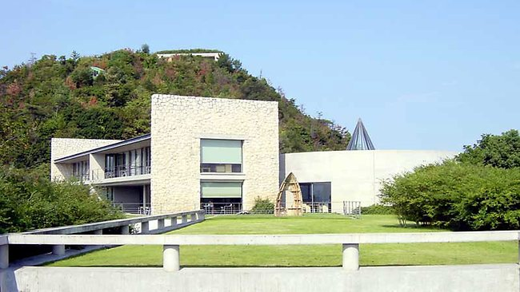
Uno house

Slide 16
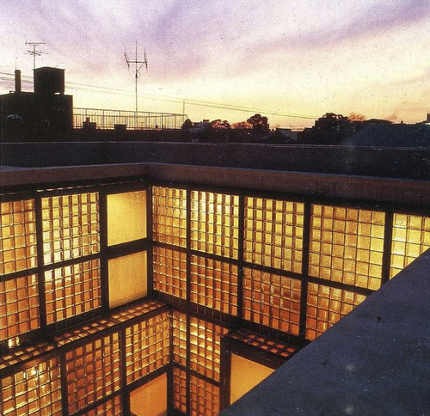
Glass block house

Slide 17
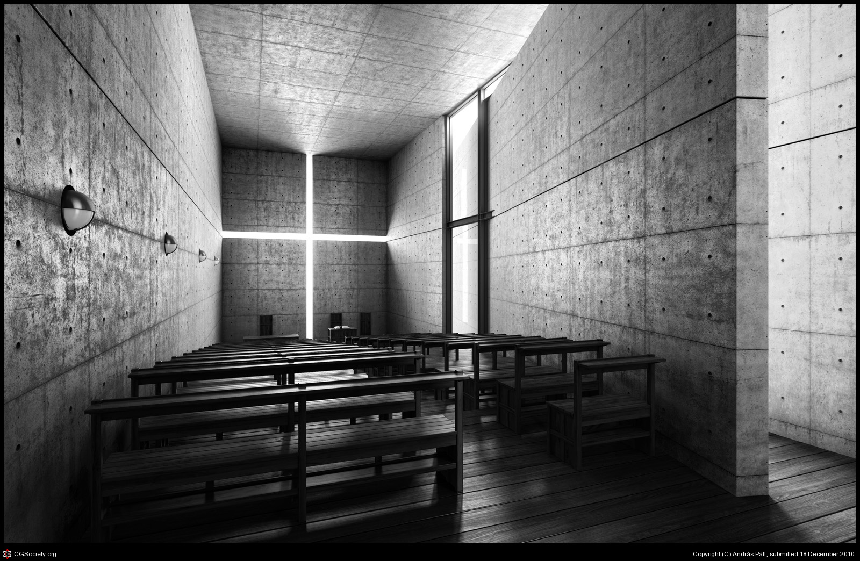
Church of the light

Slide 18
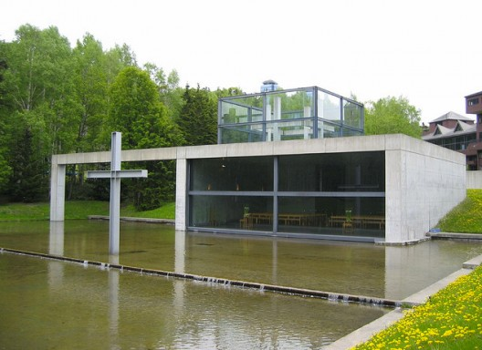
Church of water

Slide 19
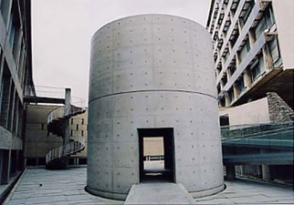
Meditation space UNESCO

Slide 20
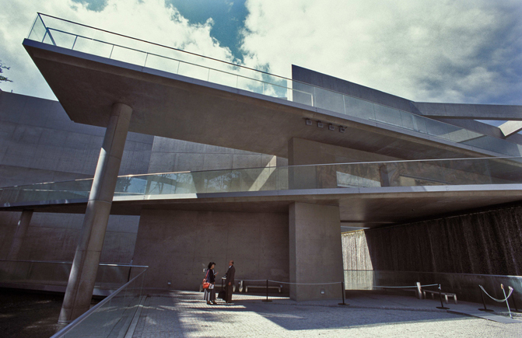
Garden of fine arts

Slide 21
Awards
Annual Prize (Row House, Sumiyoshi)
Cultural Design Prize (Rokko Housing One and Two)
Alvar Aalto Medal
Gold Medal of Architecture
Carlsberg Architectural Prize (International)
Japan Art Academy
PrizeAsahi
PrizePritzker Architecture Prize (International)

Slide 22
Chevalier de l’Ordre des Arts et des LettresPraemium Imperiale First “FRATE SOLE” Award in Architecture
Officier de l'Ordre des Arts et des LettresRoyal
Gold Medal
AIA Gold Medal
Kyoto PrizePerson of Cultural Merit
UIA Gold Medal
Order of Culture
Neutra Medal for Professional Excellence

Slide 23
Azuma House
Architect:Tadao Ando
Location:Osaka,Japan
Date:1976
Building Type: row house, small house
Construction System:concrete
Climate:semitropical
Land area:65m²
Context: dense
urbanStyle:Modern
Notes: A very small house in a narrow slot site, with rooms at front and back connected by open-air bridge through courtyard.

Slide 24
Details
Site area: 57 sq meters
Building area: 34 sq meters
Total floor area: 65 sq meters
term of planning: 1/1975-8/1975
term of construction: 10/1975-2/1976
site area: 57.28 sq. meters
total floor area: 64.72 sq. meters

Slide 25
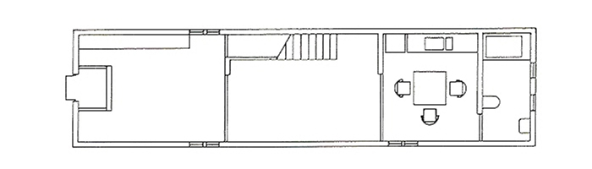
Ground floor plan

Slide 26
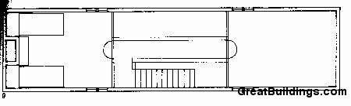
Upper floor plan

Slide 27
Concept
Built between medians, this apartment is perched on a lot of 57.3 m². The total square fottage of 64.7 m² is divided into three equal sections: two floors and a patio.
This box of concrete occupies the entire site. The building, centripetal as far as its organization, has a tripartite structure centered around an uncovered patio.
Materials
The reinforced concrete used in this house is presented as the ornamentation for the facade.

Slide 28
The Creator's Words
"In its simple but rich spatial composition, in its expression of enclosure, and in the way light gives character to daily-life spaces, this house encapsulates an image of my architecture."

Slide 29
Azuma House Commentary
In a dense, urban core of Osaka row-houses, Ando inserted a simple, narrow concrete rectangular residence. With spaces flanking an interior courtyard, there is an attempt to return the 'contact with light, air, rain, and other natural elements' to the Japanese life-style. "In addition to providing light and serving as the focal point of family life, this small court is a spatial entity that attempts to compensate for the reduced physical space." It attempts to reinstate a traditional model using a modern vocabulary

Slide 30
Spaces
On the ground floor are located the living room and a kitchen, separated by the central outside courtyard and the staircase that leads to the upper floor, where the two bedrooms are joined by a walkway. The central uncovered area is the only source of natural light throughout the house.
The courtyard, which acts as the hub of daily life in the house, separates the living room located at one end of the ground floor from the kitchen-dining room and bathroom, located in another end. On the top floor, the children's rooms on one side face the master bedroom on the other side of the central courtyard, which is reached by a bridge. The building shows a blind or solid facade to the street. The presence of a door suggests the use of this box

Slide 31
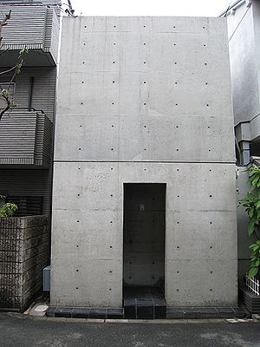
Azuma House

Slide 32
